Slide 1
Module - 3 (Clipping and Projections) Window to viewport transformation. Cohen Sutherland Line clipping algorithm. Sutherland Hodgeman Polygon clipping algorithm. Three dimensional viewing pipeline. Projections- Parallel and Perspective projections. Visible surface detection algorithms- Depth buffer algorithm, Scan line algorithm.

Slide 2

THE VIEWING PIPELINE
 Window: A world-coordinate area selected for display. The window defines what is to be viewed
 Viewport : An area on a display device to which a window is
mapped. The viewport defines where it is to be displayed.
 Windows and viewports are rectangles in standard position, with the rectangle edges parallel to the coordinate axes.
 Viewing transformation:
The mapping of a part of a world-coordinate scene to device coordinates.
2D viewing transformation is also called
window-to- windowing
viewport transformation or the
transformation.

Slide 3
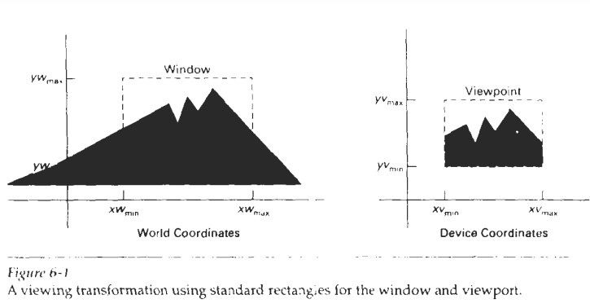

Slide 4
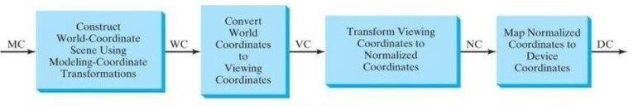
Steps in 2D viewing pipeline

Slide 5
The viewing transformation is carried out in several steps.
 First, we construct the scene in world coordinates using the output primitives and attributes.
 Next. to obtain a particular orientation for the window, we can set up a two-dimensional viewing-coordinate system in the world-coordinate plane, and define a window in the viewing- coordinate system.
 The viewing coordinate reference frame is used to provide a method for setting up arbitrary orientations for rectangular windows.
 Once the viewing reference frame is established, we can transform descriptions in world coordinates to viewing coordinates.
 We then define a viewport in normalized coordinates (in the range from 0 to 1) and map the viewing-coordinate description of the scene to normalized coordinates.
 At the final step, all parts of the picture that are outside the viewport are clipped, and the contents of the viewport are transferred to device coordinates.

Slide 6
WINDOW-TO-VIEWPORT COORDINATE TRANSFORMATION
 Once object descriptions have been transferred to the viewing
reference frame, | we choose | the window extents | in viewing
coordinates and | select the | viewport limits in | normalized
coordinates.
 Object descriptions are then transferred to normalized device coordinates.
 We do this using a transformation that maintains the same relative placement of objects in normalized space as they had in viewing coordinates.
 If a coordinate position is at the center of the viewing window,
for instance, it will be displayed at the center of the viewport.

Slide 7
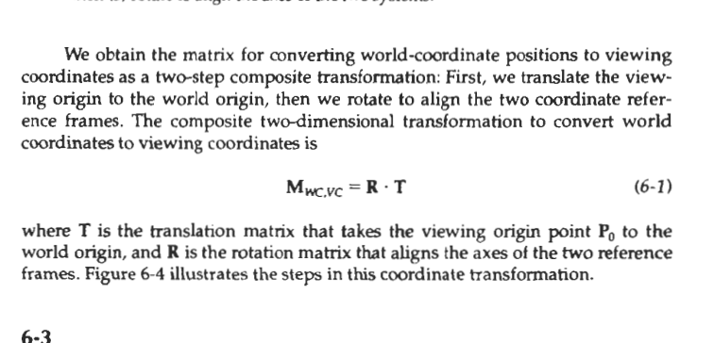

Slide 8
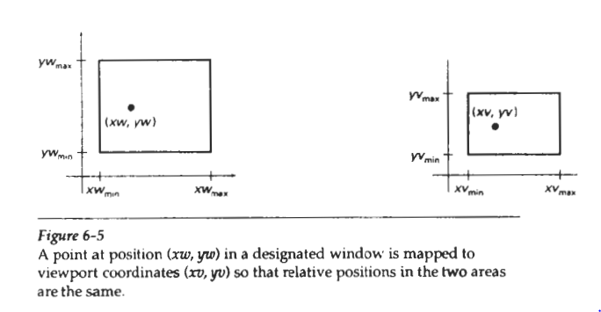
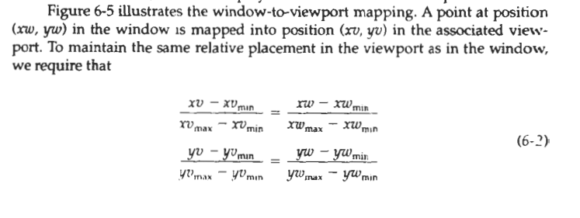

Slide 9
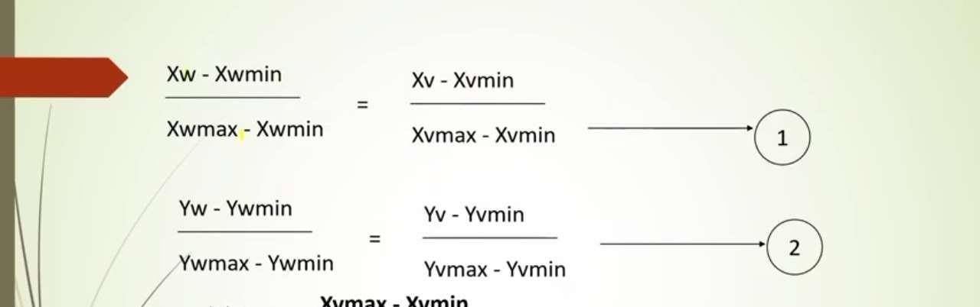
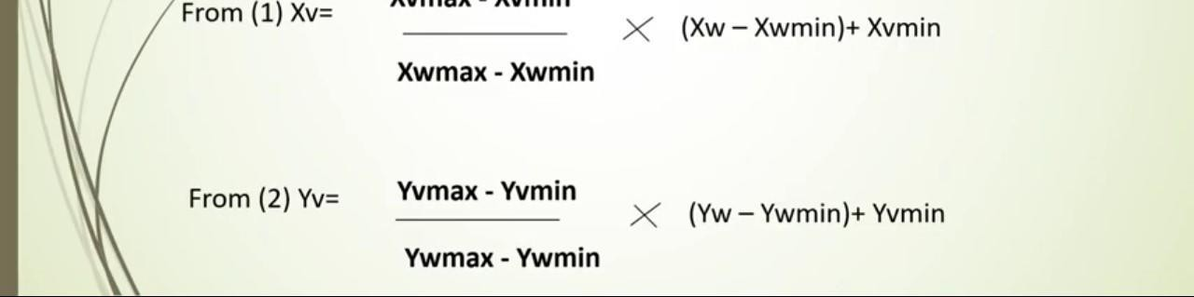

Slide 10
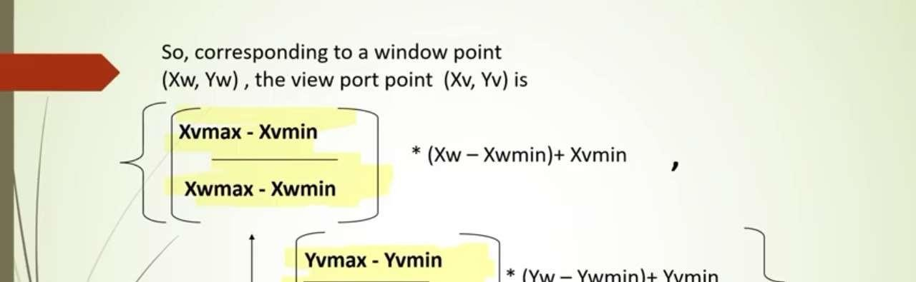
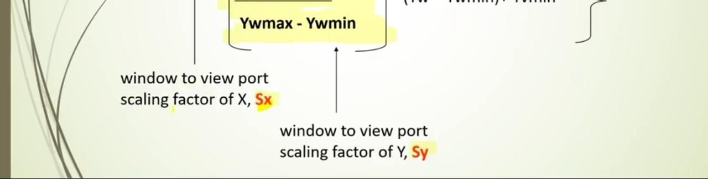

Slide 11
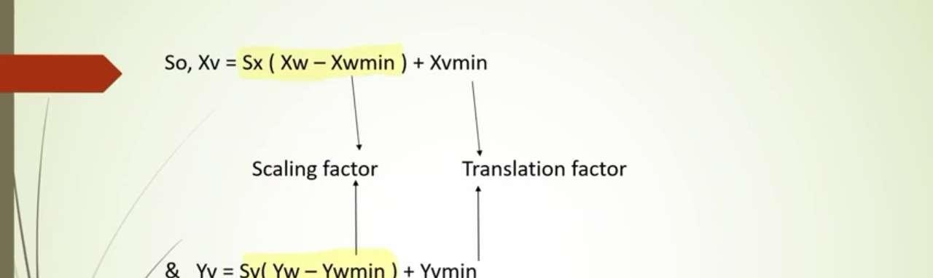
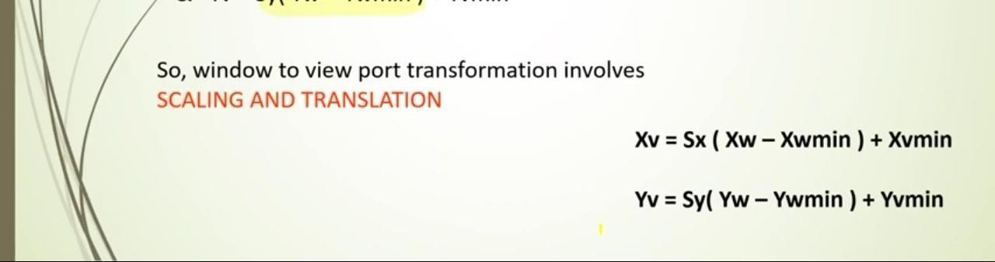

Slide 12
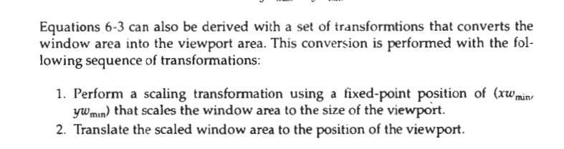

Slide 13
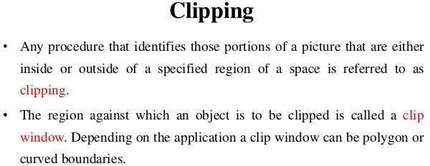
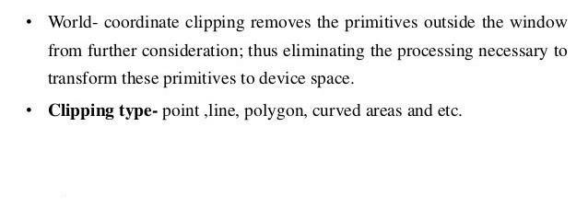

Slide 14
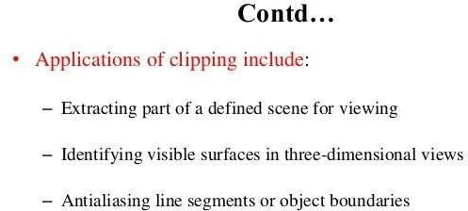
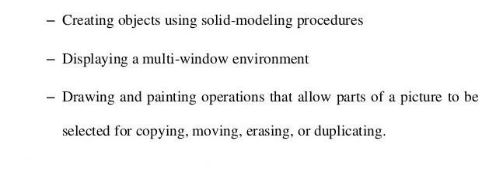

Slide 15
Clipping algorithms can be applied in world coordinates, so that only the contents of the window interior are mapped to device coordinates called world coordinates clipping
Alternatively, the complete world-coordinate picture can be mapped first to device coordinates, or normalized device coordinates, then clipped against the viewport boundaries called viewport clipping
World-coordinate clipping removes those primitives outside the window from further consideration, thus eliminating the processing necessary to transform those primitives to device space.
viewport clipping requires the transformation to device coordinates be performed for all objects, including those outside the window area..

Slide 16
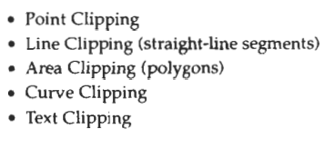
Different types of clipping are

Slide 17
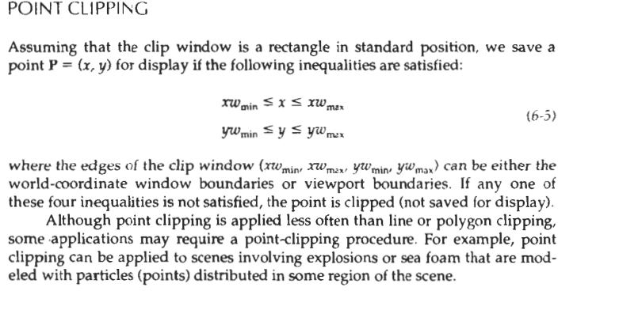

Slide 18
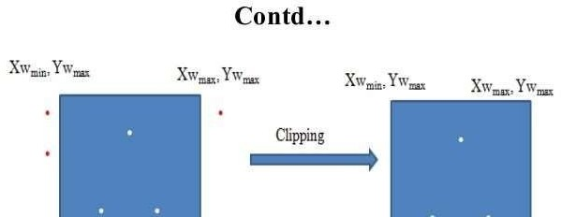
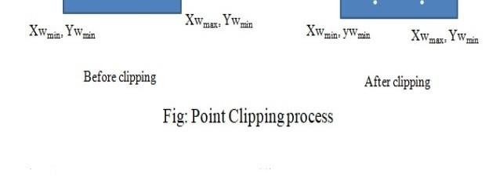

Slide 19
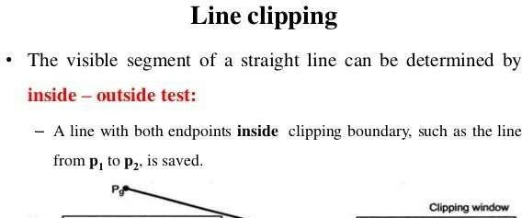
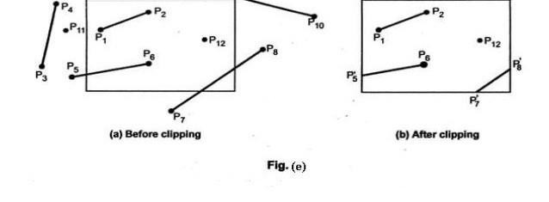

Slide 20
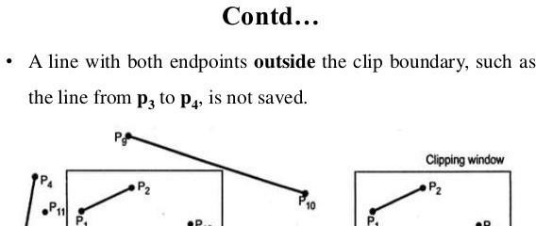
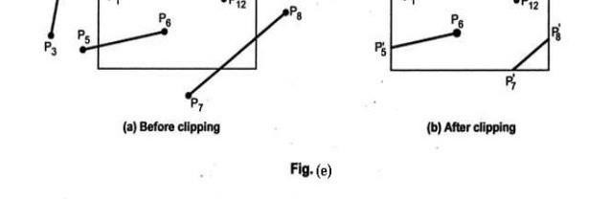

Slide 21
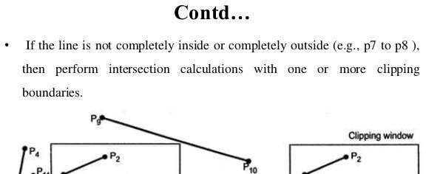
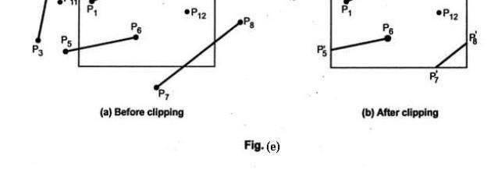

Slide 22
A line clipping procedure involves several parts.
First, we can test a given line segment to determine whether it lies completely inside the clipping window.
If it does not, we try to determine whether it lies completely outside the window.
Finally, if we cannot identify a line as completely inside or completely outside, we must perform intersection calculations with one or more clipping boundaries
We process lines through the "inside-outside'' tests by checking the line endpoints.
A line with both endpoints inside all clipping boundaries, such as the line from P1 to P2 is saved.

Slide 23
A line with both endpoints outside any one of the clip boundaries line P3P4, is outside the window.
All other lines cross one or more clipping boundaries, and may require calculation of multiple intersection points.
To minimize calculations, we try to devise clipping algorithms that can efficiently identify outside lines and can reduce intersection calculations

Slide 24
 For a line segment with endpoints (x1,y1) and (x2, y2) and one or both endpoints outside the clipping rectangle, the parametric representation
x=x1+u (x2-x1)
y=y1+u(y2-y1) where 0<=u<=1
Could beused to determine values of parameter u for intersections with clipping boundary coordinates.
 If the value of u for an intersection with a rectangle boundary edge is outside the range 0 to 1, the line does not enter the interior of the window at that boundary.
 If the value of u is within the range from 0 to 1, the line segment does indeed cross into the clipping area.

Slide 25
 This method can be applied to each clipping boundary edge in turn to determine whether any part of the line segment is to be displayed.
 Line segments that are parallel to window edges can be handled as special cases.
 Clipping line segments with these parametric tests requires a good deal of computation, and faster approaches to clipping are possible.

Slide 26
Line clipping algorithms
Cohen Sutherland algorithm

Slide 27
Cohen Sutherland algorithm
Generally, the method speeds up the processing of line segments by performing initial tests that reduce the number of intersections that must be calculated.
Every line end point in a picture is assigned a four-digit binary code, called a region code, that identifies the location of the point relative to the boundaries of the clipping rectangle.
Regions are set up in reference to the boundaries.
Each bit position in the region code is used to indicate one of the four relative coordinate positions of the point with respect to the clip window: to the left, right, top, or bottom.
By numbering the bit positions in the region code as 1 through 4 from right to left, the coordinate regions can be correlated with the bit position

Slide 28
Bit values in the region code are determined by comparing endpoint coordinate values (x, y) to the clip boundaries.
Bit 1 is set to 1 if x < xwmin
Bit 2 is set to 1 if x>xwmax
Bit 3 is set to 1 if y<ywmin
Bit 4 is set to 1 if y>ywmax
For languages in which bit manipulation is possible, region-code bit values can be determined with the following two steps:
(1) Calculate differences between endpoint coordinates and clipping boundaries.
(2) Use the resultant sign bit of each difference calculation to set the corresponding value in the region code.
Bit 1 is the sign bit of x – xwmin
bit 2 is the sign bit of xwmax - x;
bit 3 is the sign bit of y – ywmin
bit 4 is the sign bit of ywmax - y.
Negative sign bit 1
Positive sign bit 0

Slide 29
After establishing region codes for all line endpoints, we can quickly determine which lines are completely inside the clip window and which are clearly outside.
Any lines that are completely contained within the window boundaries have a region code of 0000 for both endpoints we trivally accept these lines
Any lines that have a 1 in the same bit position in the region codes for each endpoint are completely outside the clipping rectangle, and we trivially reject these lines.
We would discard the line that has a region code of 1001 for one endpoint and a code of 0101 for the other endpoint. Both endpoints of this line are left of the clipping rectangle, as indicated by the 1 in the first bit position of each region code.
A method that can be used to test lines for total clipping is to perform the logical and operation with both region codes. If the result is not 0000, the line is completely outside the clipping region.
Lines that cannot be identified as completely inside or completely outside a clip window by these tests are checked for intersection with the window boundaries

Slide 30
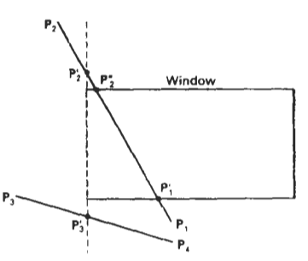
we show how the lines in Fig could be processed. Starting with the bottom endpoint of the line from P1 to P2
we check P1 against the left, right, and bottom boundaries in turn and find that this point is below the clipping rectangle.
We then find the intersection point P1’ with the bottom boundary and discard the line section from P1’to P1.
The line now has been reduced to the section from P1’ to P2
Since P2 is outside the clip window, we check this endpoint against the boundaries and find that it is to the left of the window. Intersection point P2’ is calculated, but this point is above the window.
So the final intersection calculation yields P2’’, and the line from P1’to P2’’

Slide 31
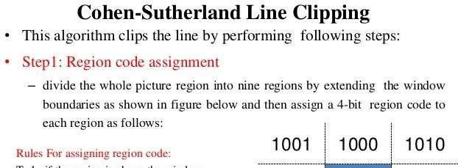
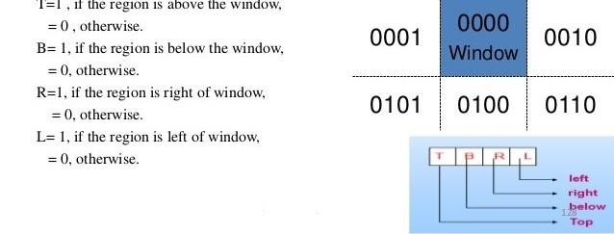

Slide 32
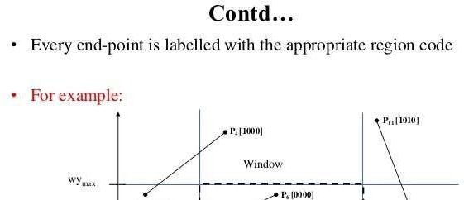
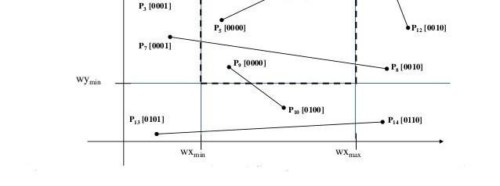

Slide 33
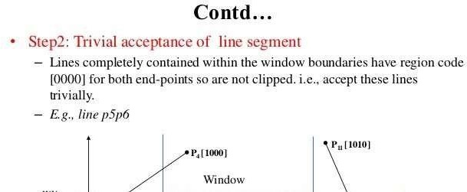
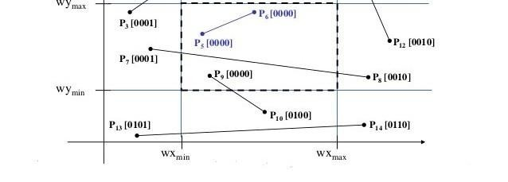

Slide 34
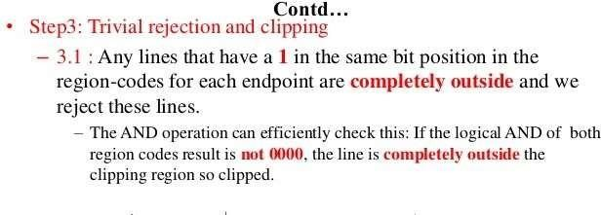
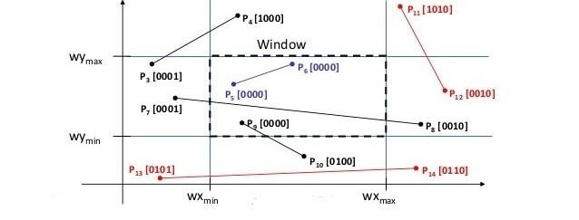

Slide 35
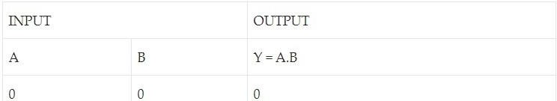
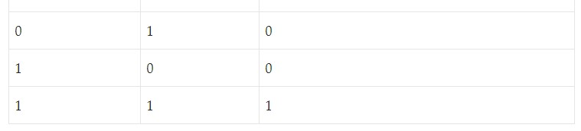
AND operation

Slide 36
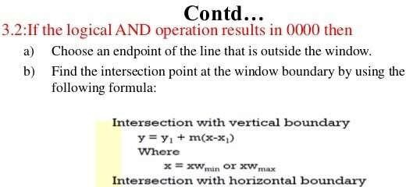
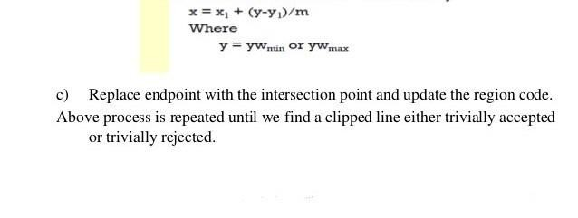

Slide 37
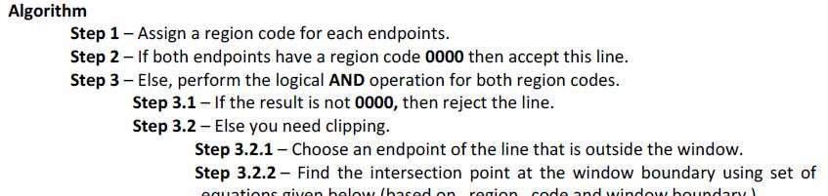
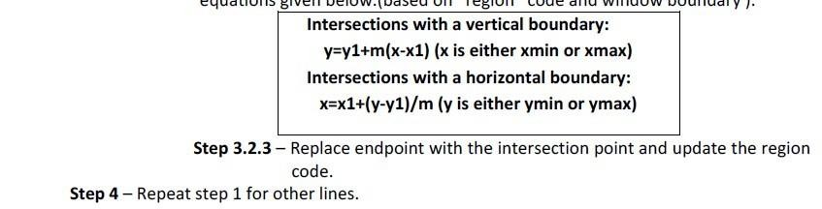

Slide 38
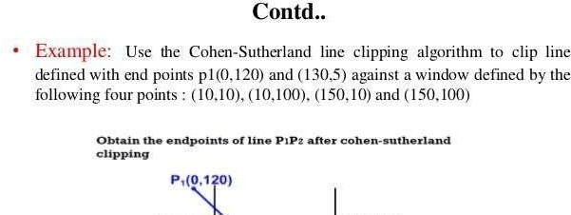
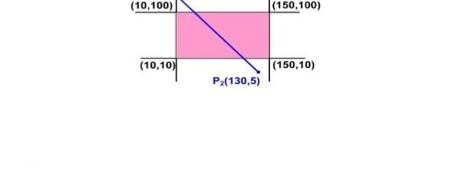

Slide 39
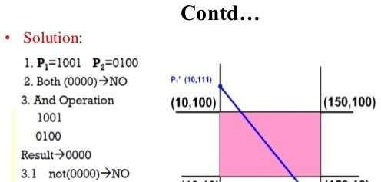
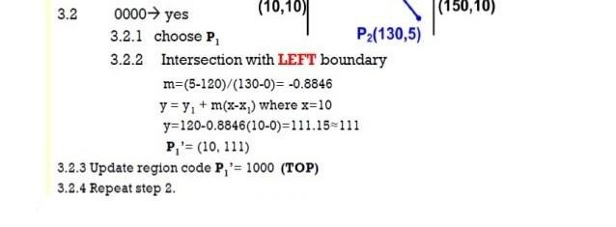

Slide 40
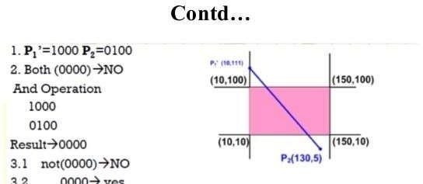
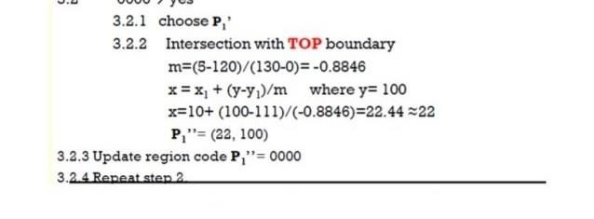

Slide 41
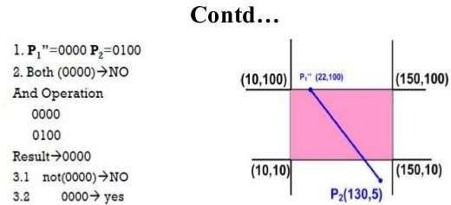
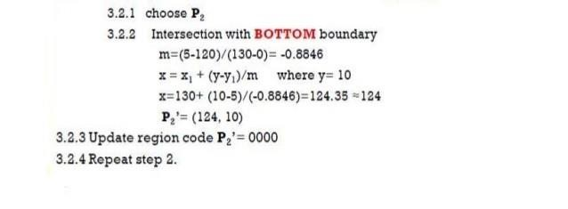

Slide 42
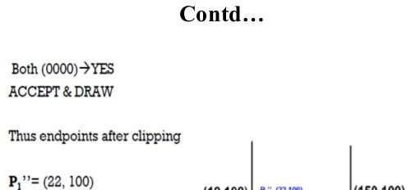


Slide 43

POLYGON CLIPPING
To clip polygons, we need to modify the line-clipping procedures discussed in the previous section.
A polygon boundary processed with a line clipper may be displayed as a series of unconnected line segments (Fig. 6-17), depending on the orientation of the polygon to the cIipping window.
we require an algorithm that wiIl generate one or more closed areas that are then scan converted for the appropriate area fill.
The output of a polygon clipper should be a sequence of vertices that defines the clipped polygom boundaries.

Slide 44

Sutherland-Hodgeman Polygon Clipping
We can correctly clip a polygon by processing the polygon boundary as a whole against each window edge.
This could be accomplished by processing all polygon vertices against each clip rectangle boundary in turn.
Beginning with the initial set of polygon vertices, first clip the polygon against the left rectangle boundary to produce a new sequence of vertices.
The new set of vertices could then k successively passed to a right boundary clipper, a bottom boundary clipper, and a top boundary clipper, as in Fig
At each step, a new sequence of output vertices is generated and passed to the next window boundary clipper

Slide 45
Four possible cases when processing vertices in sequence around the perimeter of a polygon. As each pair of adjacent polygon vertices is passed to a window boundary clipper, we make the following tests:
(1) If the first vertex is outside the window boundary and the second vertex is inside, both the intersection point of the polygon edge with the window boundary and the second vertex are added to the output vertex list.
(2) If both input vertices are inside the window boundary, only the second vertex is added to the output vertex list.
(3) if the first vertex is inside the window boundary and the second vertex is outside, only the edge intersection with the window boundary is added to the output vertex list.
(4) If both input vertices are outside the window boundary, nothing is added to the output list..
Once all vertices have been processed for one clip window boundary, the output lisst of vertices is clipped against the next window boundary.

Slide 46


Slide 47



Slide 48

Three Dimensional Viewing Pipeline

Slide 49
Figure shows the general processing steps for modeling and converting a world-coordinate description of a scene to device coordinates.
Once the scene has been modeled, world-coordinate positions are converted to viewing coordinates.
The viewing-coordinate system is used in graphics packages as a reference for specifying the observer viewing position and the position of the projection plane, which we can think of in analogy with the camera film plane.
Next, projection operations are performed to convert the viewing-coordinate description of the scene to coordinate positions on the projection plane, which will then be mapped to the output device.
Objects outside the specified viewing limits are clipped from further consideration, and the remaining objects are processed through visible-surface identification and surface-rendering procedures to produce the display within the device viewport.

Slide 50

PROJECTIONS
Projection is mapping or transformation from 3D view into 2D view
ie., world-coordinate descriptions of the objects in a scene are converted to viewing coordinates
There are 2 types of projection
1 parallel projection
In a parallel projection, coordinate positions are transformed to the viewed plane along parallel lines, as shown in the ,example of Fig.
A parallel projection preserves relative proportions of objects, and this is the method used in drafting to produce scale drawings of three-dimensional object
Accurate views of the various sides of an object are obtained with a parallel projection, but this does not give us a realistic representation of the appearance of a three-dimensional object.

Slide 51


2 Perspective Projection
For a perspective projection the object positions are transformed to the view plane along lines that converge to a point called the projection reference point (or center of projection).
The projected view of an , object is determined calculating the intersection of the projection lines with the view plane.
A perspective projection, on the other hand, produces realistic views but does not preserve relative proportions.

Slide 52

Parallel Projection
In a parallel projection, coordinate positions are transformed to the viewed plane along parallel lines
We can specify a parallel projection with a projection vector that defines the direction for the projection lines.
When the projection is perpendicular to the view plane, we have an orthographic parallel projection.
Otherwise, we have an oblique parallel projection
. Figure illustrates the two types of parallel projections.

Slide 53

1. Orthographic projections
When the projection is perpendicular to the view plane, we have an orthographic parallel projection.
Orthographic projections are most often used to produce the front, side, and top views of an object, as shown in figure Front, side, and rear orthographic projections of an object are called elevators;
And a top orthographic projection is called a plain view
Engineering and architectural drawings commonly employ these orthographic projections, because lengths and angles are accurately depicted and can be measured from the drawings.

Slide 54


Transformation equations for an orthographic parallel projection are straight forward.
If the view plane is placed at position z, along the z, axis (Fig. 12-20), then any point (x, y, z) in viewing coordinates is transformed to projection coordinates as
where the original z-coordinate value is preserved for the depth information needed in depth cueing and visible-surface determination procedures.

Slide 55
Axonometric orthographic projections.
In this Projection it display more than one face of an object. Such view are called axonometric orthographic projections.
I.e. at least three faces are shown by manipulating the object(applying basic transformation on the object)
axonometric orthographic projection are divided into 3 based on a foreshortening factor
1 isometric
2 Dimetric
3 Trimetric
foreshortening factor: It is the ratio of projected length to true length of a line
Trimetric All the three foreshortening factor(corresponding to each principal axis) different
Dimetric 2 Foreshortening factors are equal
Isometric all the three foreshortening factor are equal

Slide 56


Slide 57
An oblique projection
An oblique projection is obtained by projecting points along parallel lines that are not perpendicular to the projection plane.
In some applications packages, an oblique projection vector is specified with two angles, alpha and phi ,
Point (x, y, z) is projected to position (xp yp,) on the view plane.
Orthographic projection coordinates on the plane are (x, y).
The oblique projection line from (x, y, z) to (xp yp) makes an angle alpha with the line on the projection plane that joins (xp yp) and (x, y).
This line, of length L distance between (xp yp) and (x, y). L makes and angle phi with the horizontal direction in the projection plane.

Slide 58


Slide 59






Z/L
where L, is the inverse of tan alpha, which is also the value of L when z = 1. We can then write the oblique projection equations as

Slide 60

Oblique is divided into based on alpha
1 Cavelier and
2 Cabinet Projection
Cavalier Projection The value of alpha =45 ie tan alpha =1( alpha is the angle between projection from xyz to xpyp) and line joining (xpyp) and (xy)
All lines perpendicular to the projection plane are projected with no change in length
Cabinet Projection
perpendiculars

Slide 61


Perspective Projections
To obtained by transforming points along projection lines that meet at the projection reference point.
Suppose we set the projection reference point at position z, along the z, axis, and we place the view plane at zvp as shown in Fig.
We can write equations describing coordinate positions along this perspective projection line in parametric form as

Slide 62


Where d, = zprp - zvp is the distance of the view plane from the projection reference point.

Slide 63


In general, the projection reference point does not have to be along the i,, axis. We can select any coordinate position (xrp, yprp ,zprp,) on either side of the view plane for the projection reference point,

Slide 64


Special cases
If the view plane is taken to be the xy plane, then zvp, = 0 and the projection coordinates are
If the projection reference point is always taken to be at the viewing-coordinate origin. In this case, zprp = 0 and the projection coordinates on the viewing plane are

Slide 65
Visible surface detection
A major consideration in the generation of realistic graphics displays is identifying those parts of a scene that are visible from a chosen viewing position
There are many approaches we can take to solve this problem, and numerous algorithms have been devised for efficient identification of visible objects for different types of application
Some methods require more memory, some involve more processing time, and some apply only to special types of objects.
Deciding upon a method for a particular application can depend on such factors as the complexity of the scene, type of objects to be displayed, available equipment, and whether static or animated displays are to be generated.
Visible-surface detection algorithms are broadly classified according to whether they deal with object definitions directly or with their projected images.

Slide 66
These two approaches are called object-space methods and image-space methods,
object-space methods
An object-space method compares objects and parts of objects to each other within the scene definition to determine which surfaces, as a whole, we should label as visible.
eg back face detection and removal
image-space methods
In an image-space algorithm, visibility is decided point by point at each pixel position on the projection plane.
Eg depth buffer Scan line

Slide 67
DEPTH-BUFFER (Z- buffer Method)
A commonly used image-space approach to detecting visible surfaces is the depth-buffer method, which compares surface depths at each pixel position on the projection plane.
This procedure is also referred to as the Z-buffer method, since object depth is usually measured from the view plane along the z axis of a viewing system.
Each surface of a scene is processed separately, one point at a time across the surface.
The method is usually applied to scenes containing only polygon surfaces, because depth values can be computed very quickly and the method is easy to implement

Slide 68


Slide 69
With object descriptions converted to projection coordinates, each (x, y, z) position on a polygon surface corresponds to the orthographic projection point (x, y) on the view plane.
Therefore, for each pixel position (x, y) on the view plane, object depths can be compared by comparing z values.
Figure 13-4 shows three surfaces at varying distances along the orthographic projection line from position (x, y) in a view plane taken as the xy,, plane.
Surface s1, is closest at this position, so its surface intensity value at (x, y) is saved
We can implement the depth-buffer algorithm in normalized coordinates, so that z values range from 0 at the back clipping plane to zmax at the front clipping plane
The value of z, can be set either to 1 (for a unit cube) or to the largest value that can be stored on the system

Slide 70
Two buffer areas are required.
A depth buffer is used to store depth values for each (x, y) position as surfaces are processed,
and the refresh buffer stores the intensity values for each position.
Initially, all positions in the depth buffer are set to 0 (minimum depth), and the refresh buffer is initialized to the background intensity.
Each surface listed in the polygon tables is then processed, one scan line at a time, calculating the depth (z value) at each (x, y) pixel position.
The calculated depth is compared to the value previously stored in the depth buffer at that position.
If the calculated depth is greater than the value stored in the depth buffer, the new depth value is stored, and the surface intensity at that position is determined and in the same xy location in the refresh buffer

Slide 71


Slide 72


. If the depth of position (x, y) has been determined to be z, then the depth z' of the next position (x + 1, y) along the scan line is obtained from above equation as
The ratio -A/C is constant for each surface, so succeeding depth values across a scan line are obtained from preceding values with a single addition.
On each scan line, we start by calculating the depth on a left edge of the polygon that intersects that scan line (Fig. 13-6). Depth values at each successive position across the scan line are then calculated by Eq. 13-6

Slide 73


Slide 74

We first determine the y-coordinate extents of each polygon, and process the surface from the topmost scan line to the bottom scan line, as shown in Fig. 13-6.
Starting at a top vertex, we can recursively calculate x positions down a left edge of the polygon as x' = x - l/m, where m is the slope of the edge (Fig. 13-7).
Depth values down the edge are then obtained recursively as

Slide 75


Slide 76



Slide 77
University Questions
 Given a clipping window A(-20,-20), B(40,-20), C(40,30) and D(-20,30). Using Cohen Sutherland line clipping algorithm, find the visible portion of the line segment joining the points P(-30,20) and Q(60,-10). (6)
 Explain the Cohen Sutherland line clipping algorithm with suitable examples. (6)
 How does Cohen Sutherland algorithm determine whether a line is visible, invisible or a candidate for clipping based on the region codes assigned to the end points of the line? (4)

